Slide 1
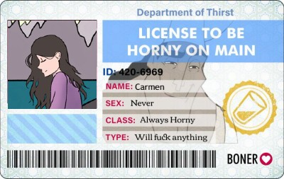
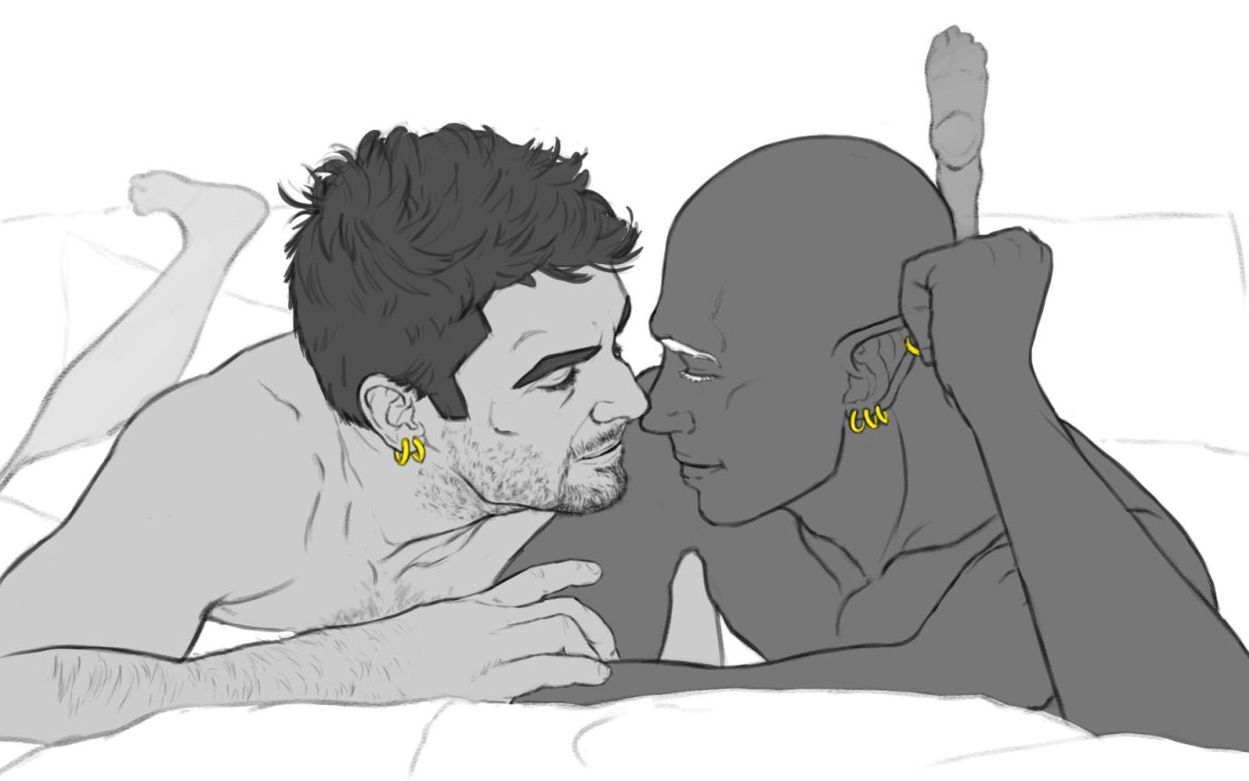

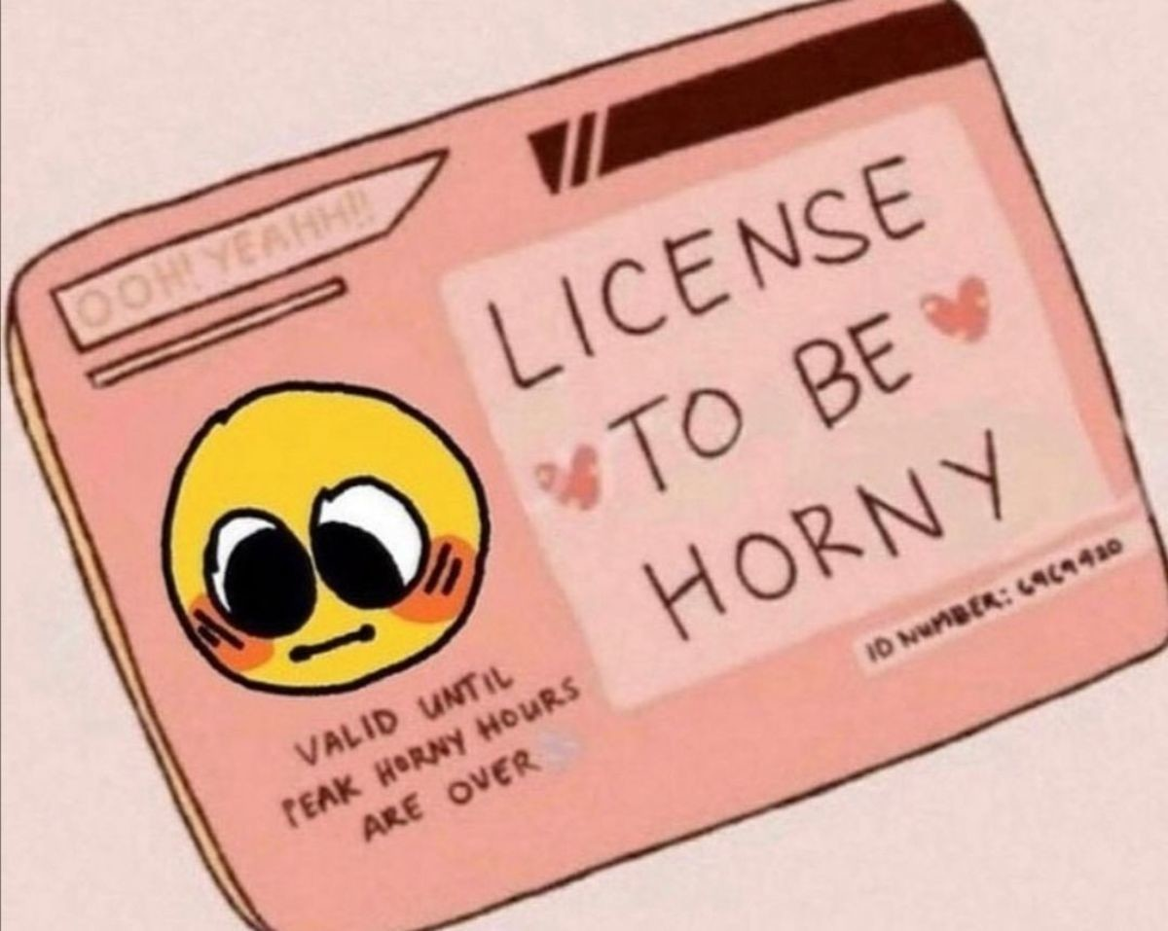


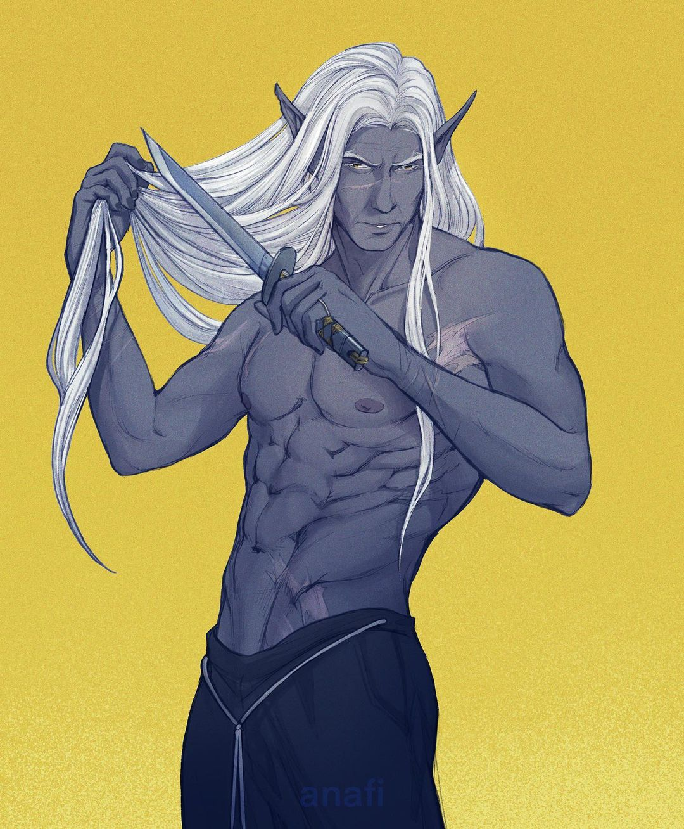
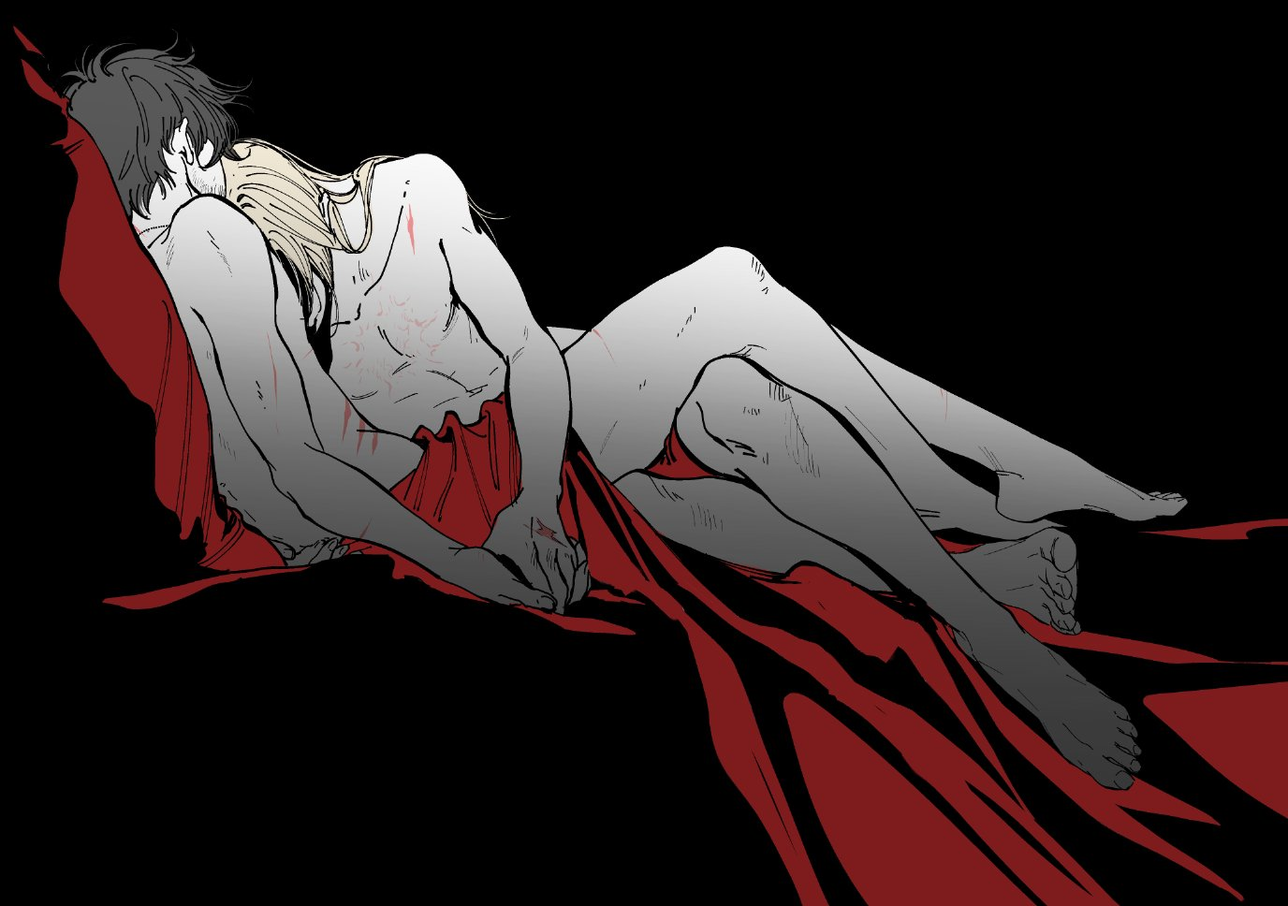
Fuck Marry KILL

Slide 2
Turns out that’s not true afterall

Slide 3
Please join me in quiz format
There are correct answers
Despite what the quiz says no time limit
I trust you to move along with the powerpoint
https://presenter.ahaslides.com/presentation/2835257

Slide 4
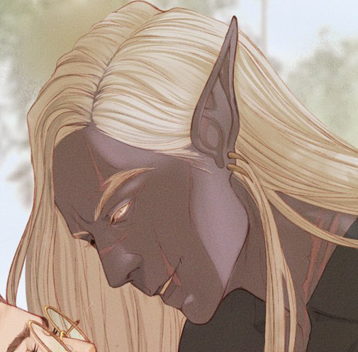
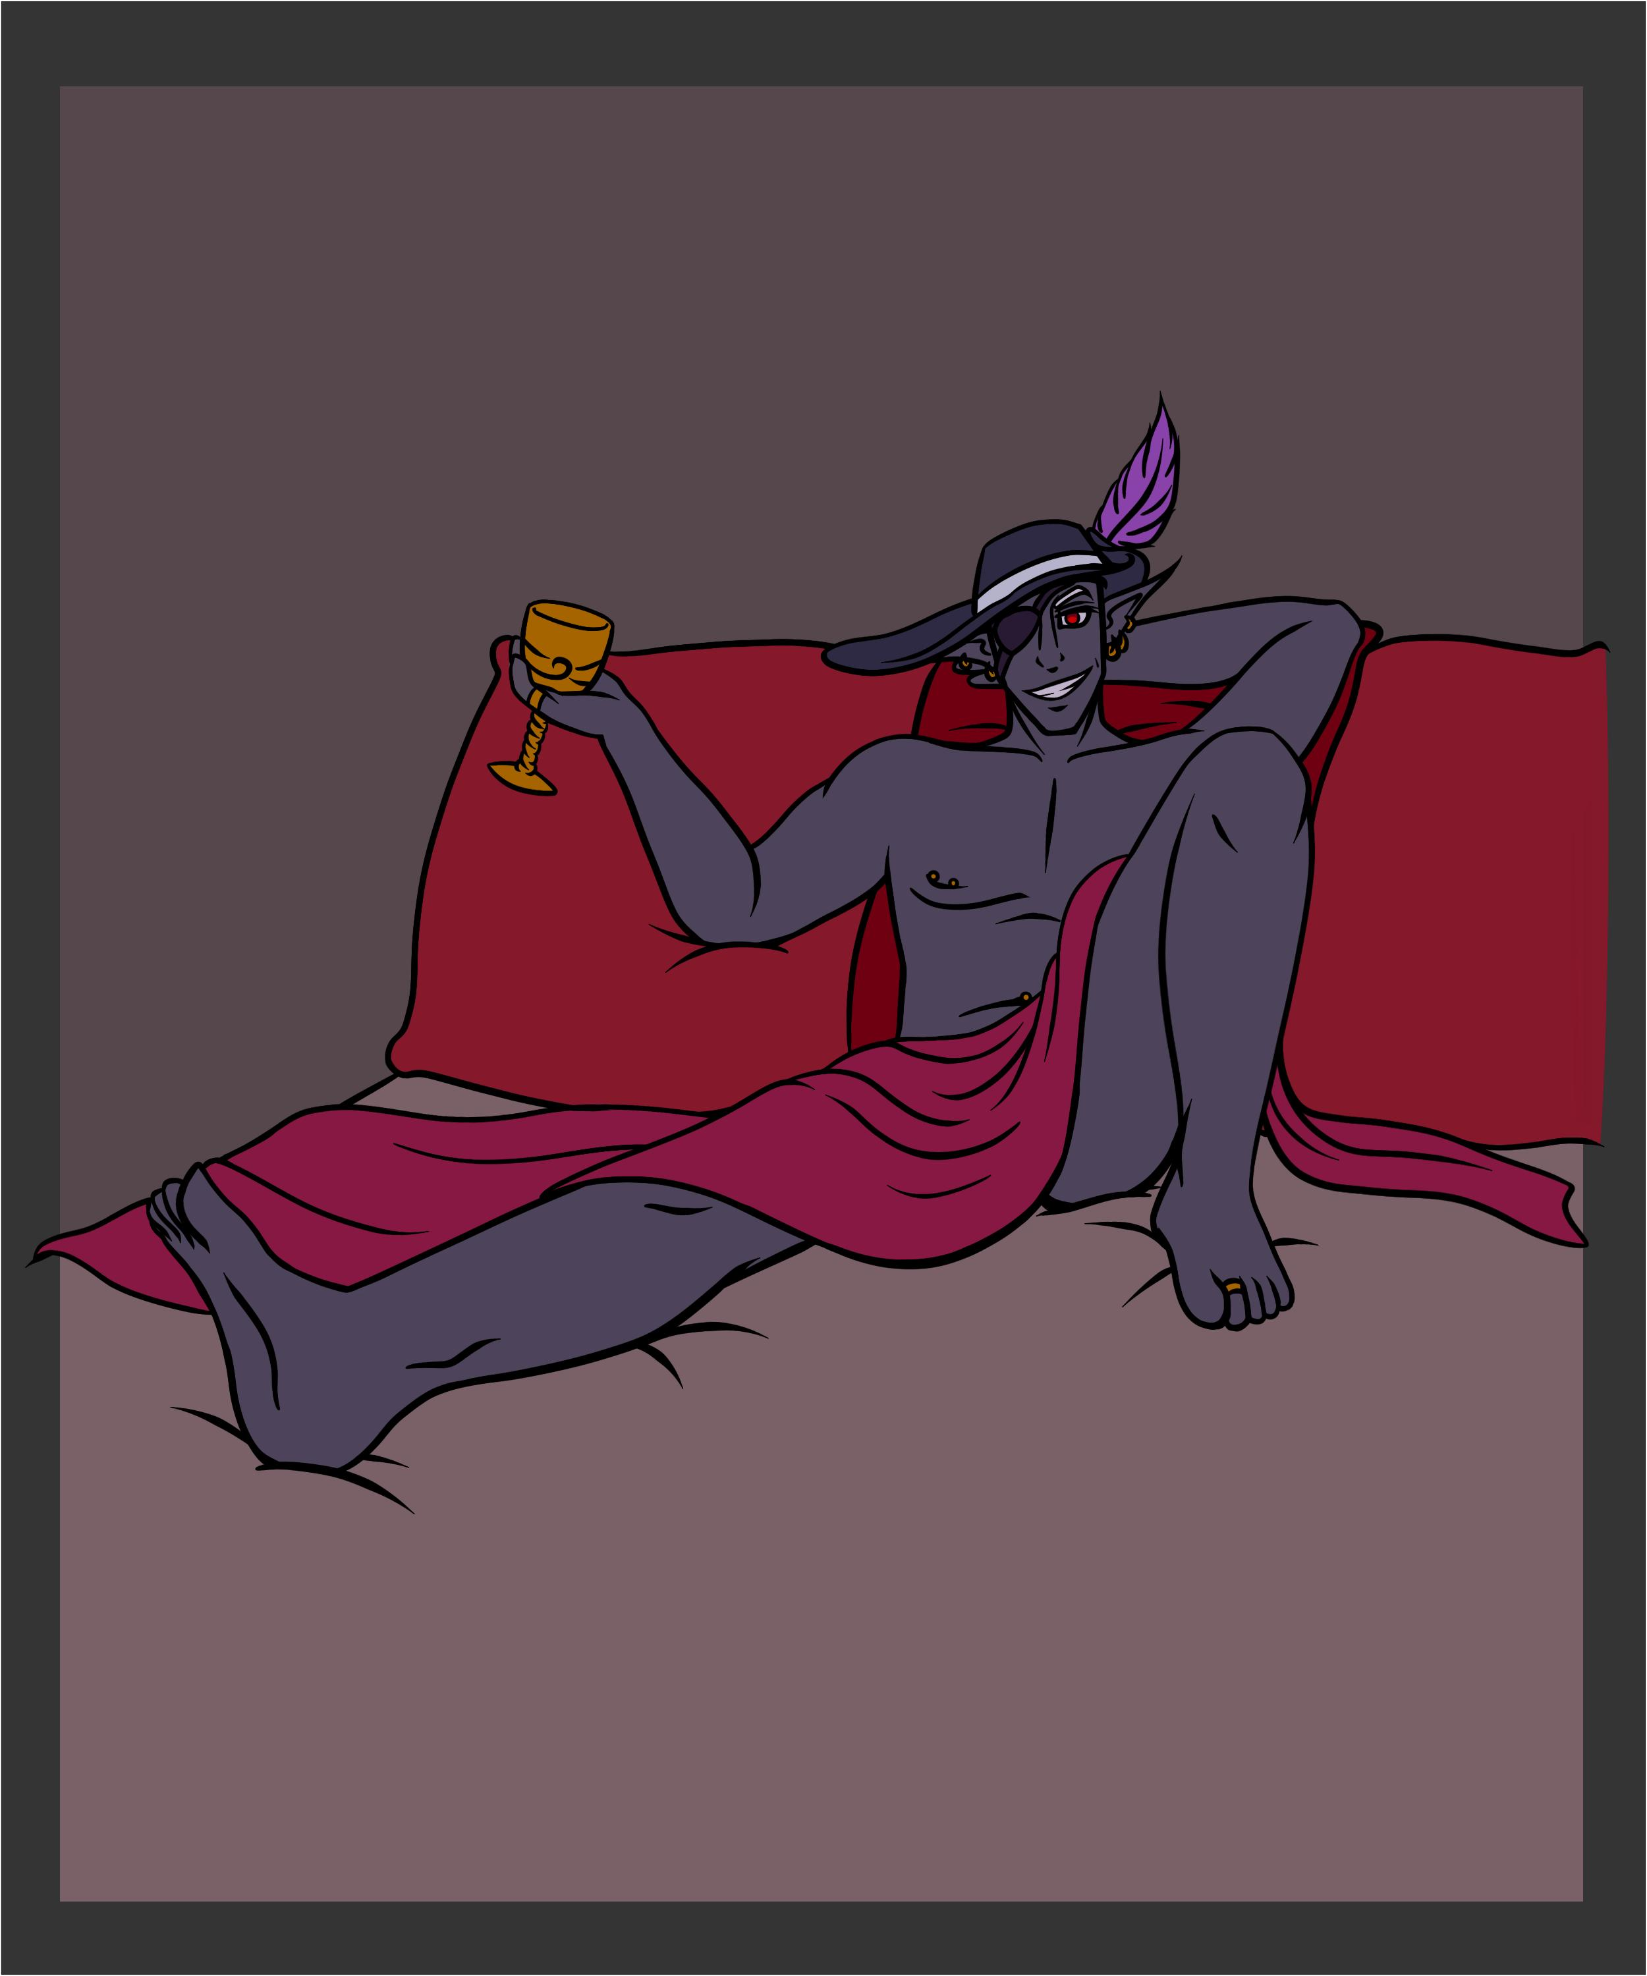

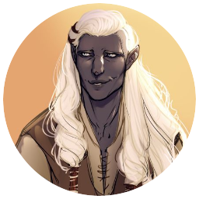
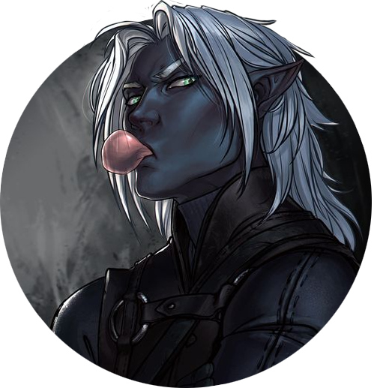
Jarlaxle, Mazati, Tripp

Slide 5
Jarlaxle, Mazati, Tripp
Marry Mazati because of course he’s so amazing
Fuck Jarlaxle UwU I think he’d be too dangerous for marriage for lil old me
Kill Tripp none of this silent type toxic masculinity for me

Slide 6
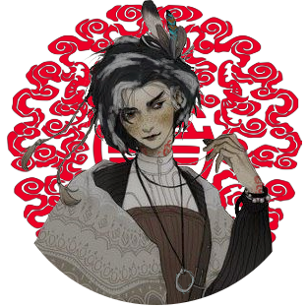

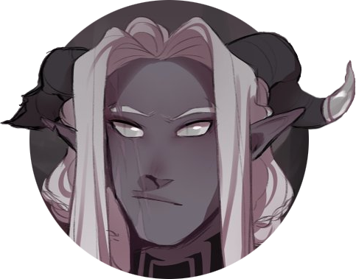

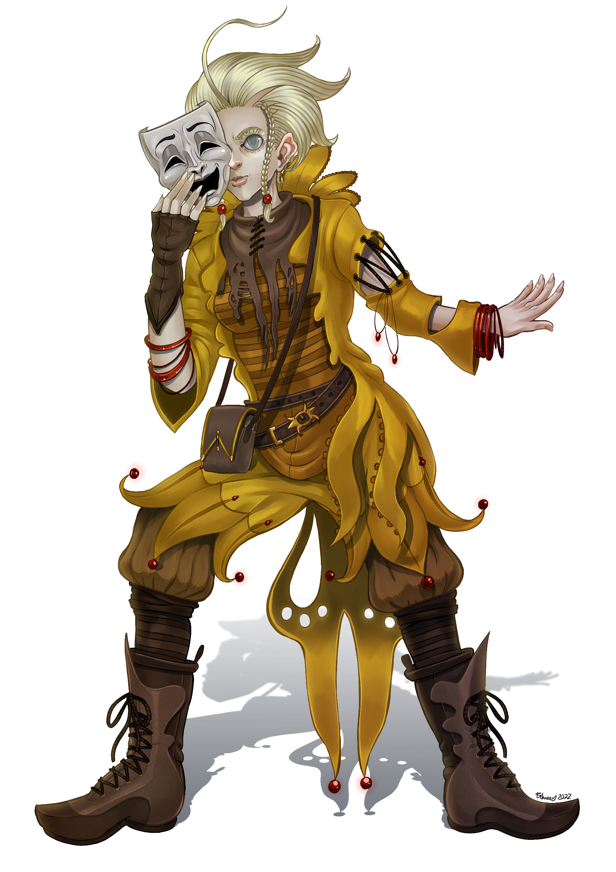
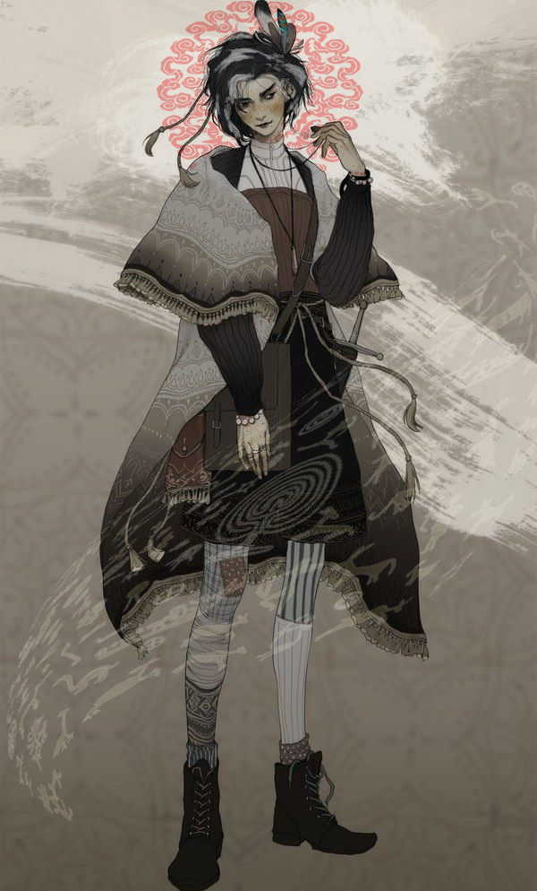
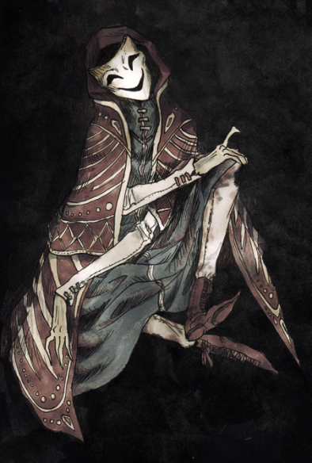
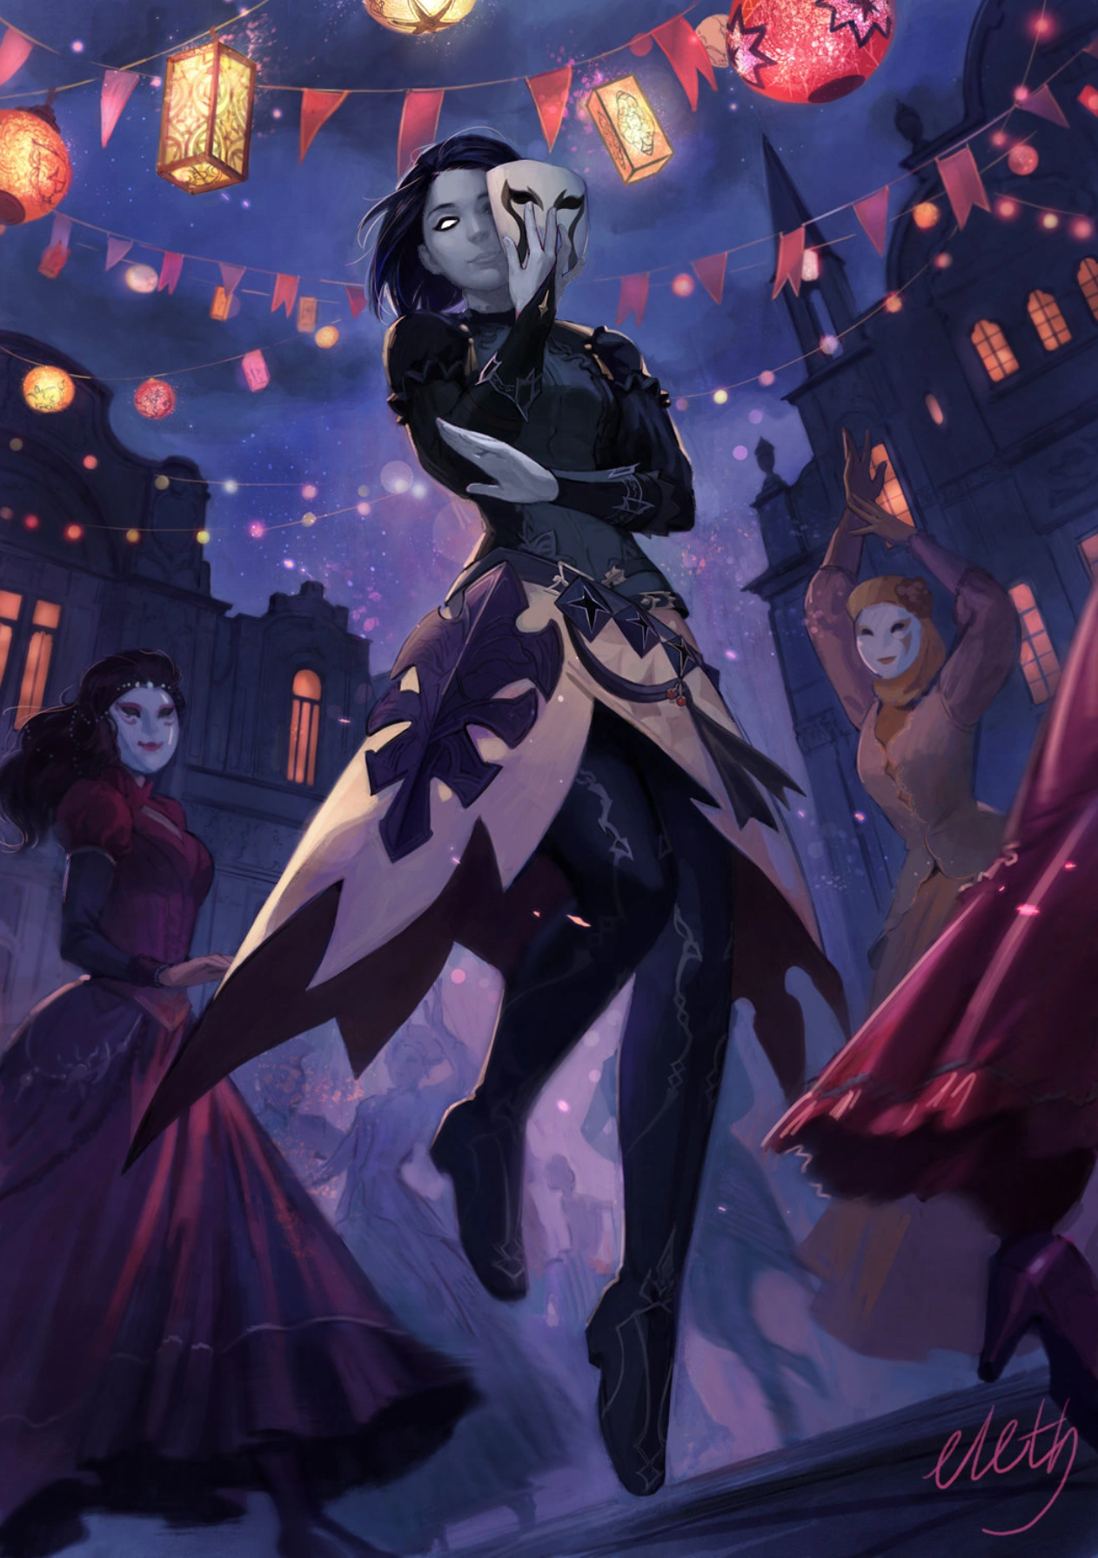
Alin, Masq, Constantine

Slide 7
Alin, Masq, Constantine
Fuck Masq UwU I imagine with shape shifting it’s pretty cool
Marry Alin, I think Alin would be so wise and a wonderful life companion
Kill constantine this bee just can’t hold up to the rest

Slide 8
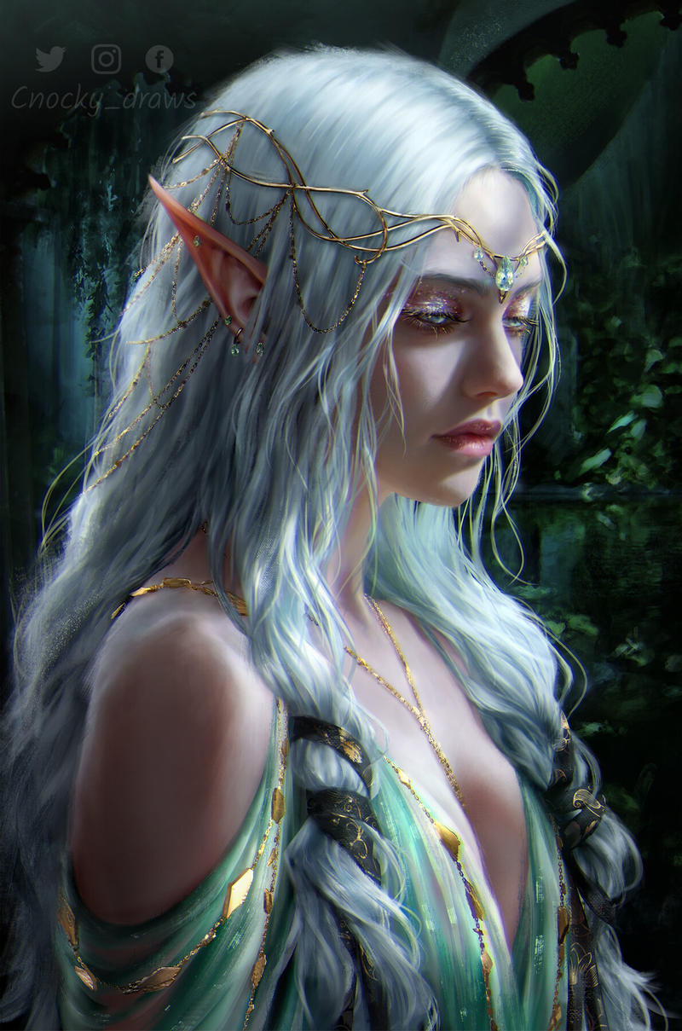
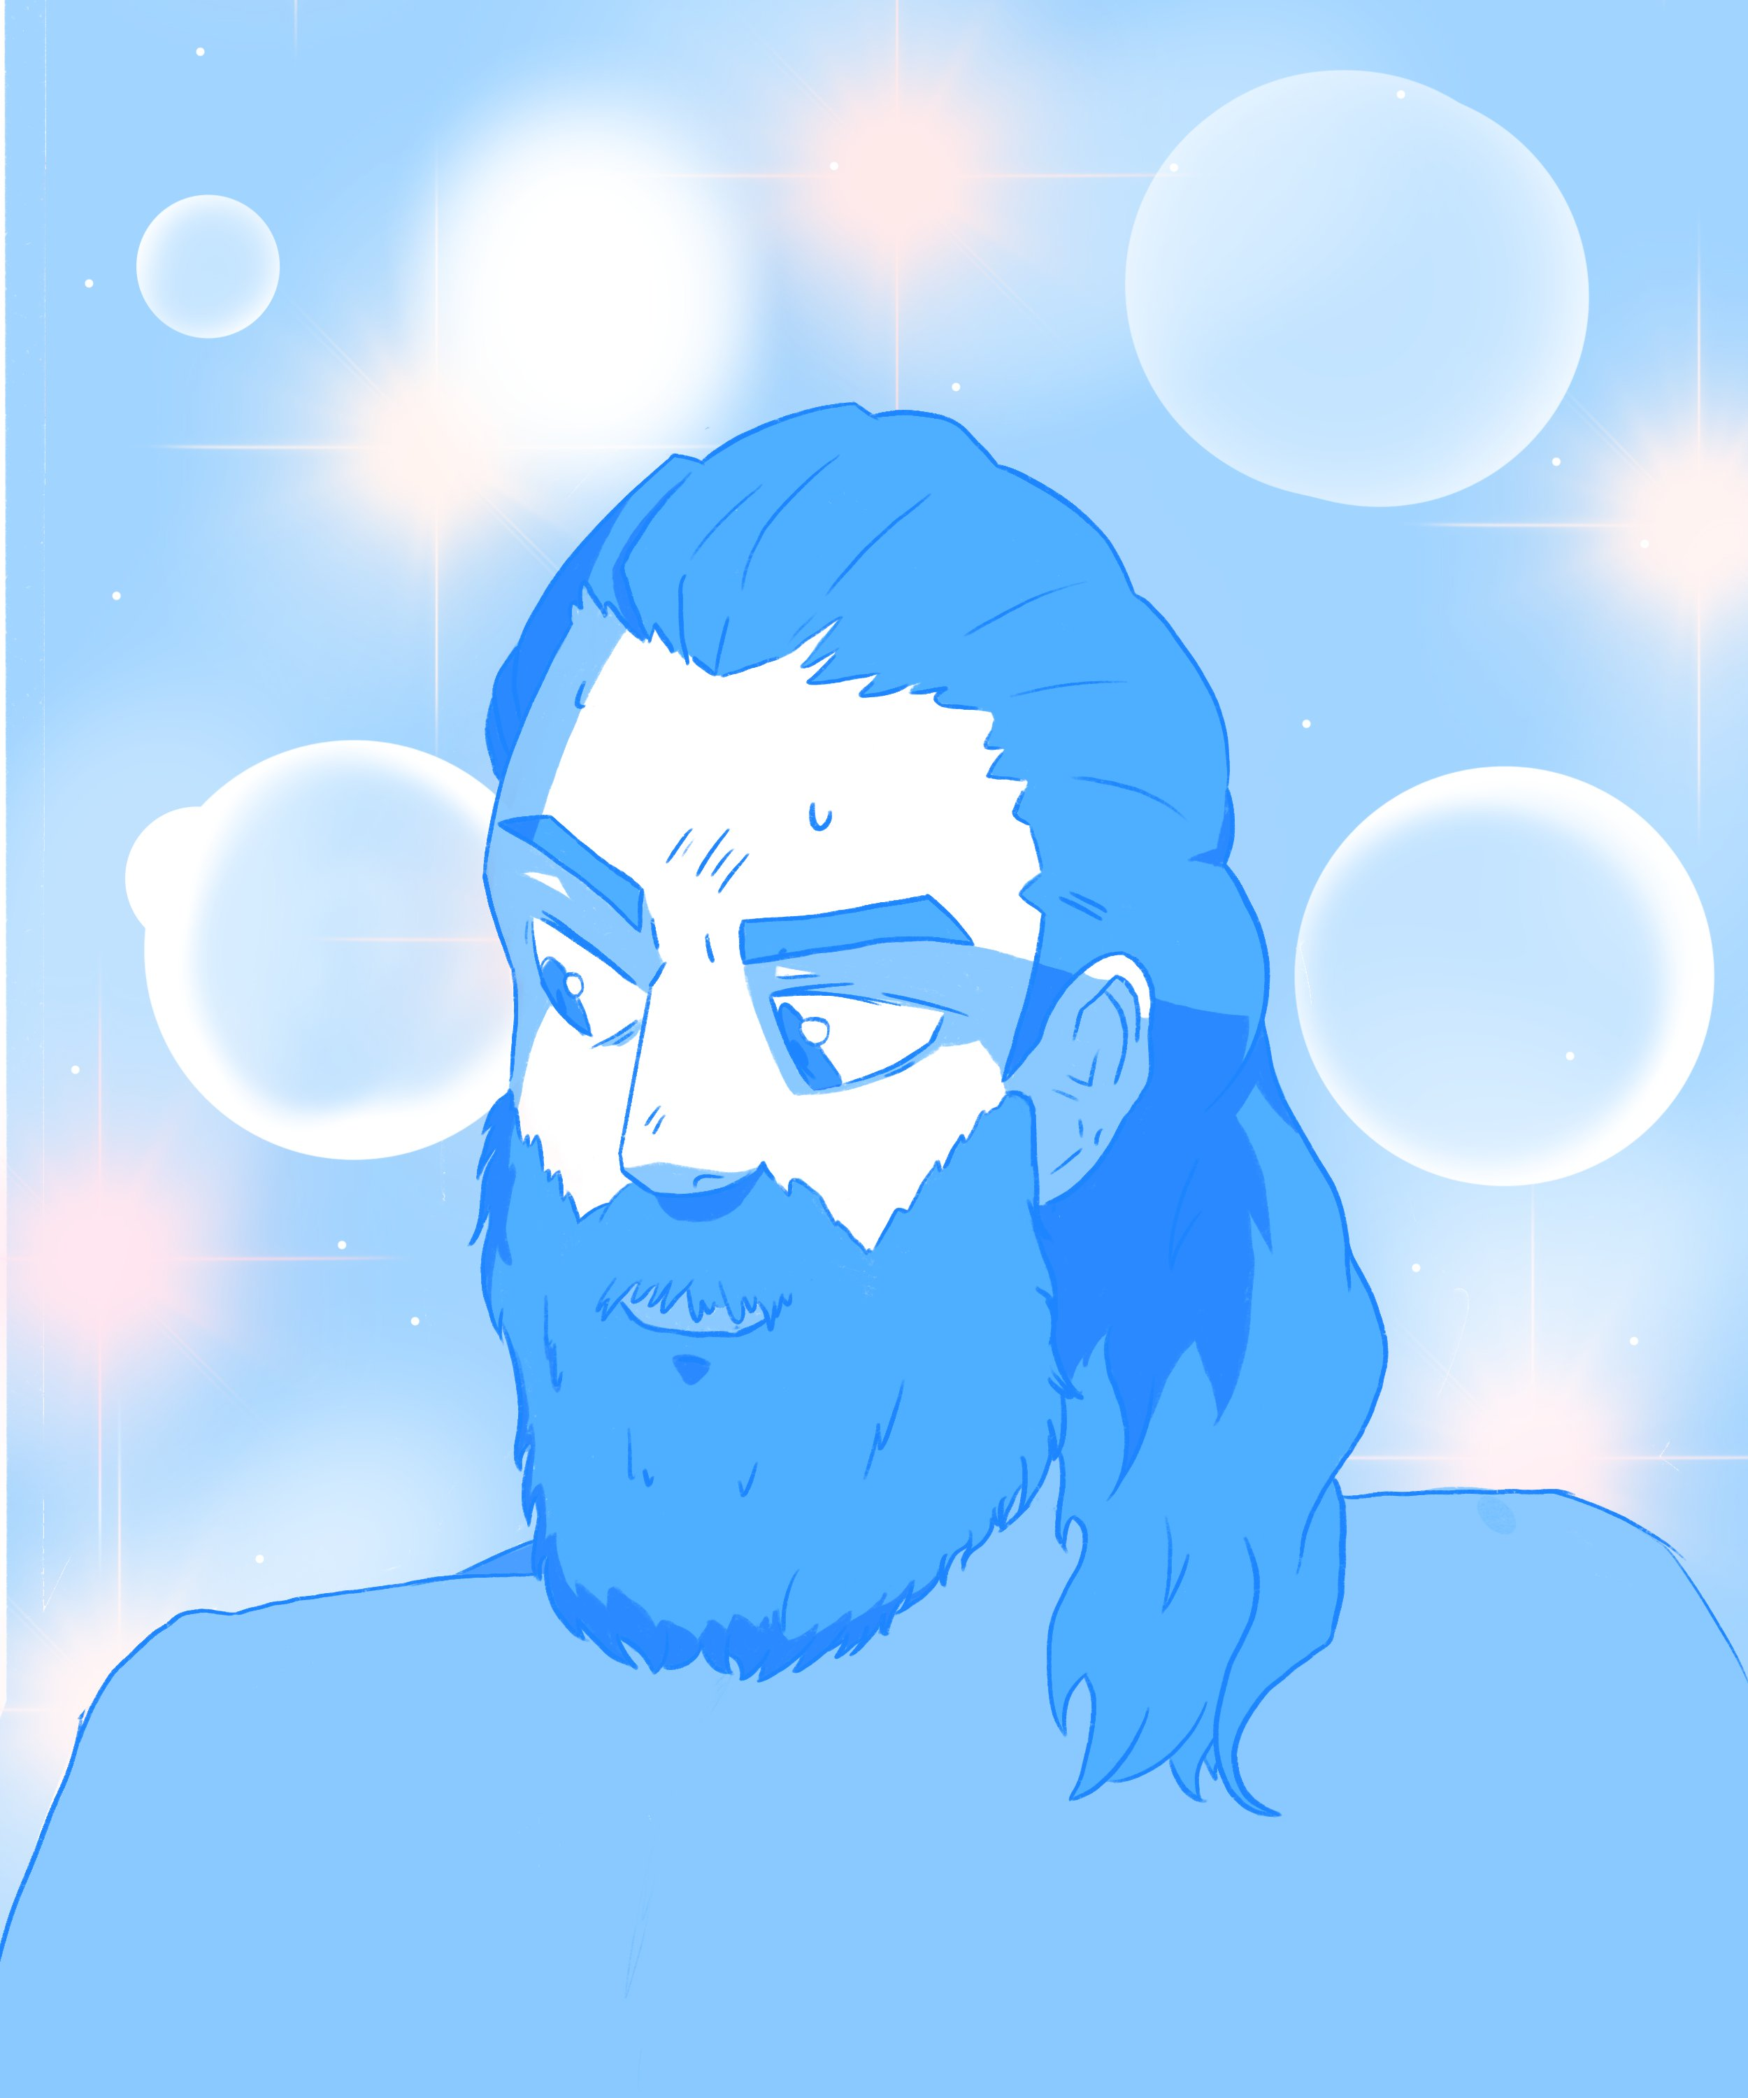

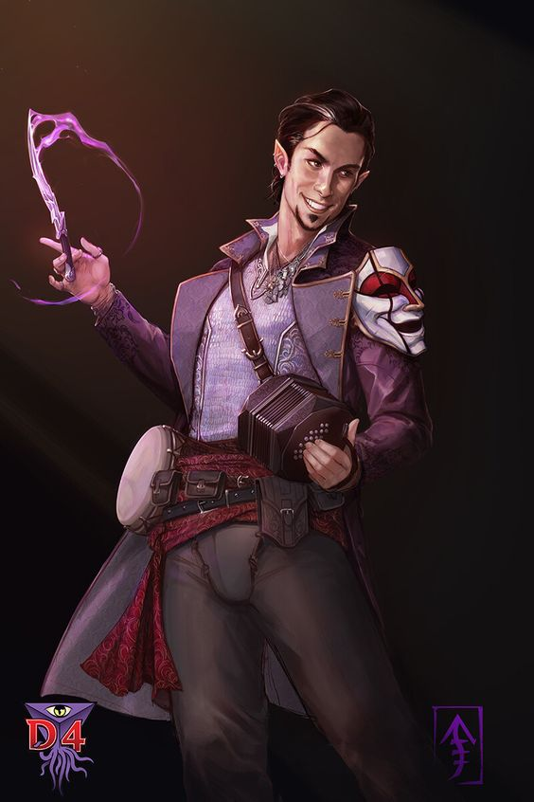
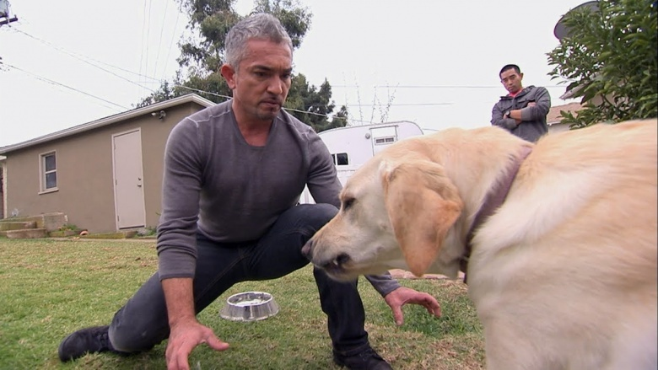

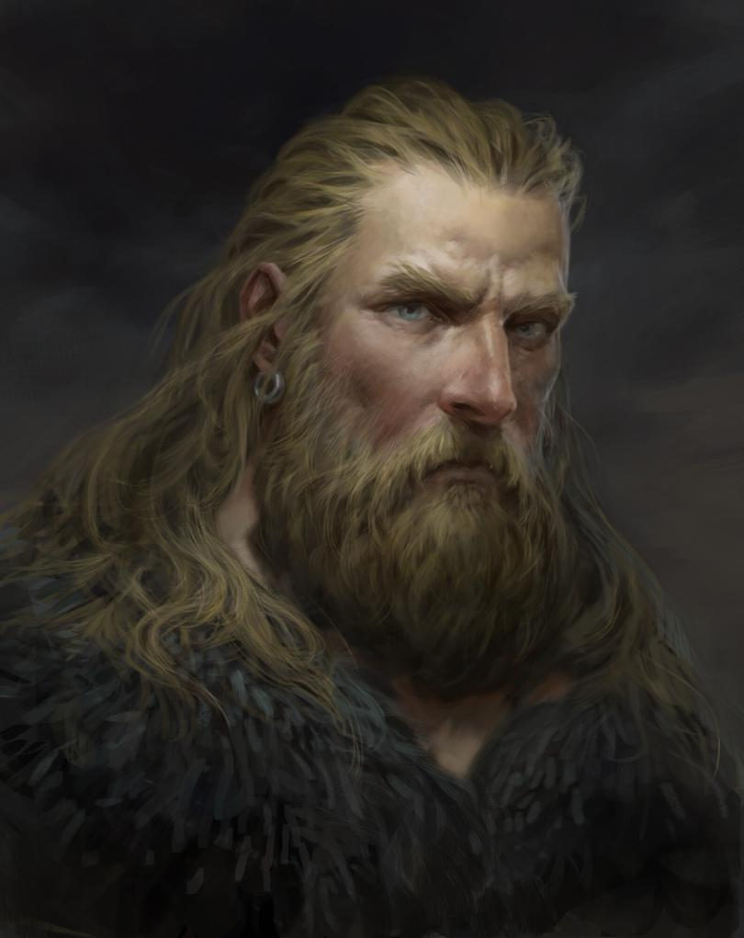

Hallbjorn, Abraxas, Delilah

Slide 9
Hallbjorn, Abraxas, Delilah
Fuck Hallbjorn, because he has the wolves, and I don’t wanna deal long term with that
Marry abraxas because this boi would never leave me, he’s a bard and I simply wouldn’t leave him in charge of the finances
Kill delilah because she wouldn’t want either of the other options

Slide 10
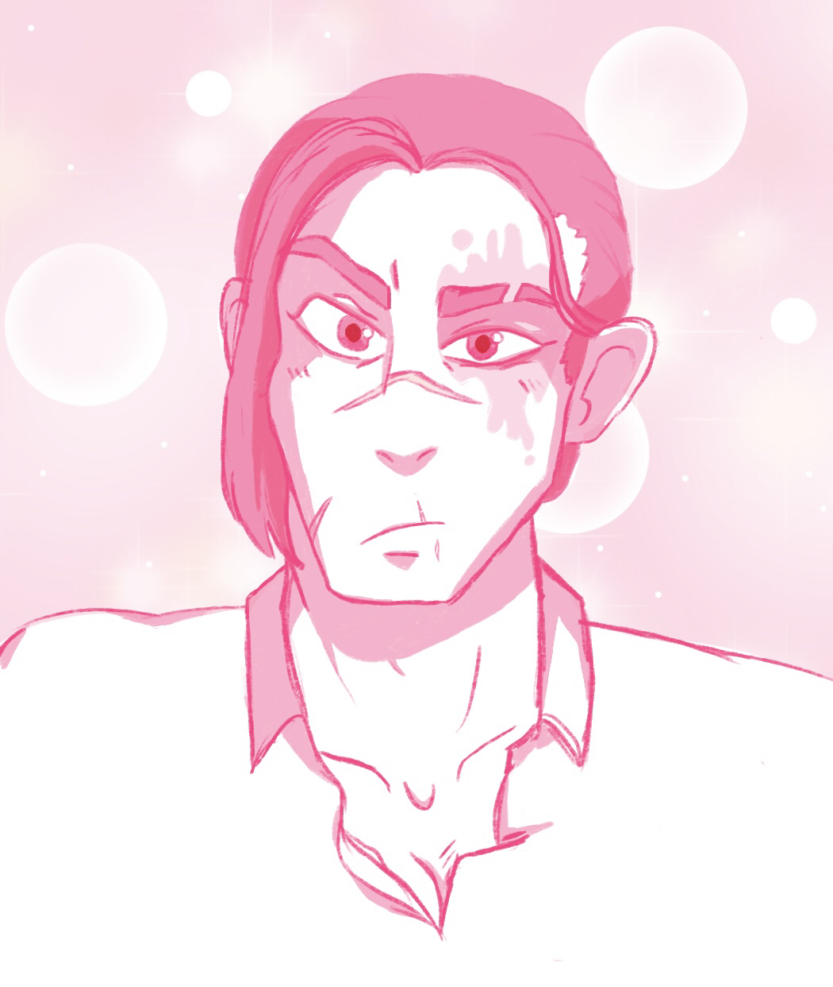
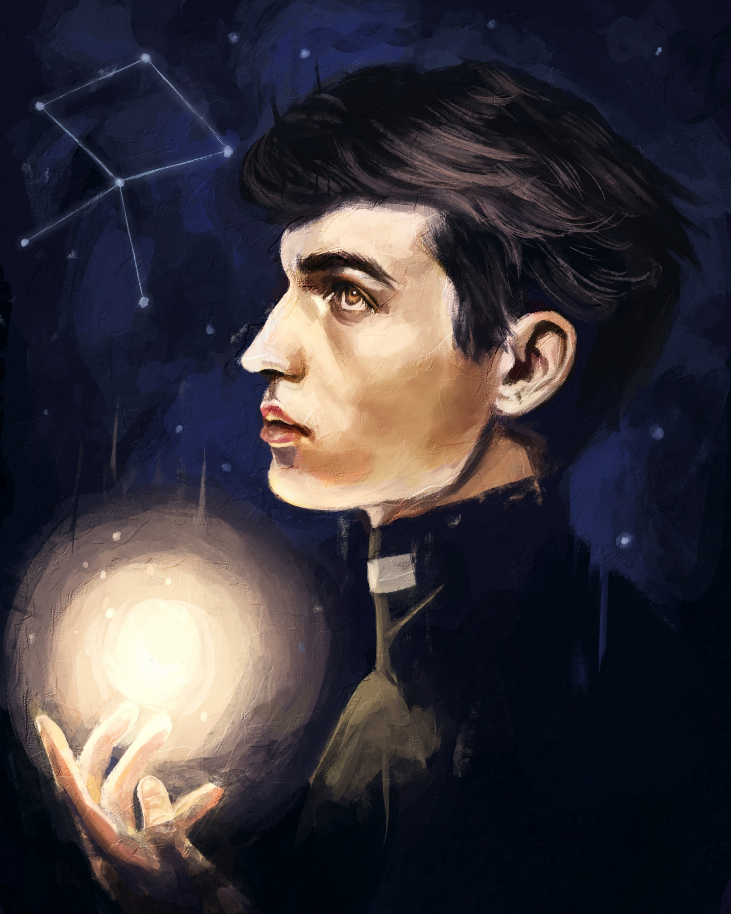
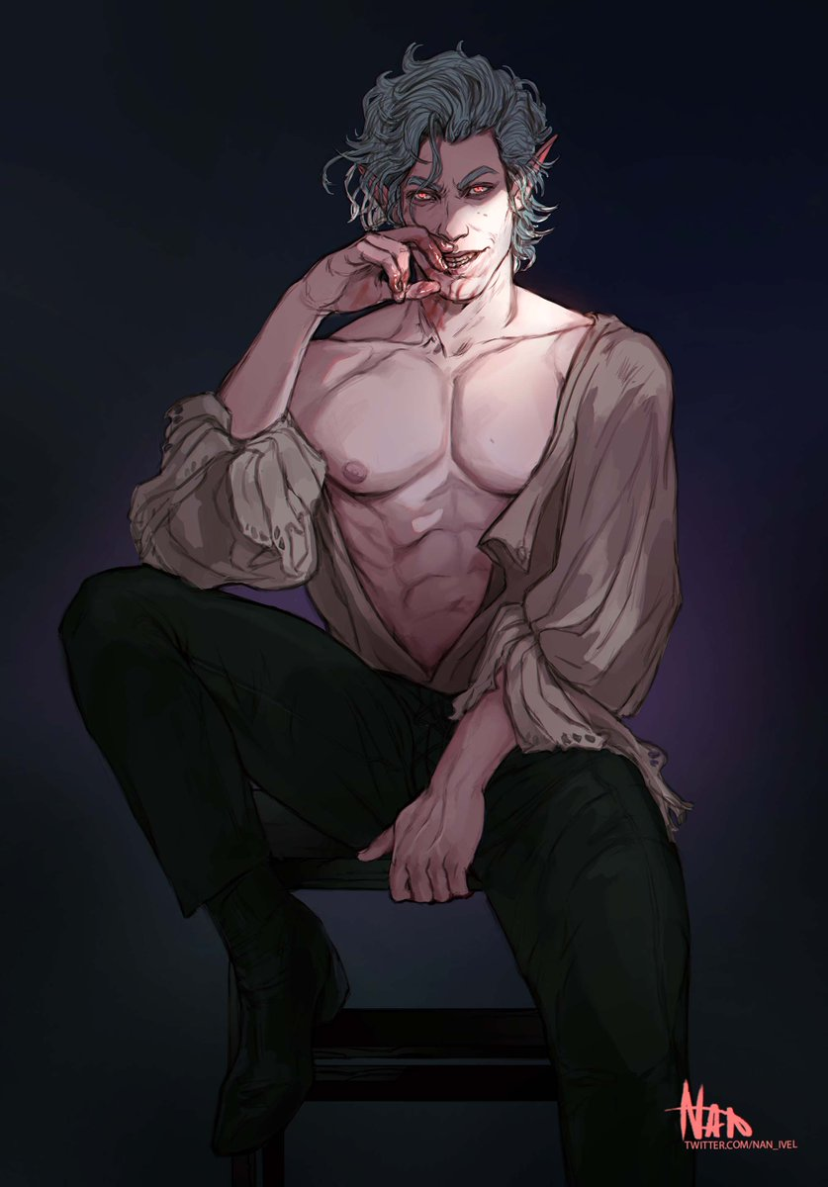
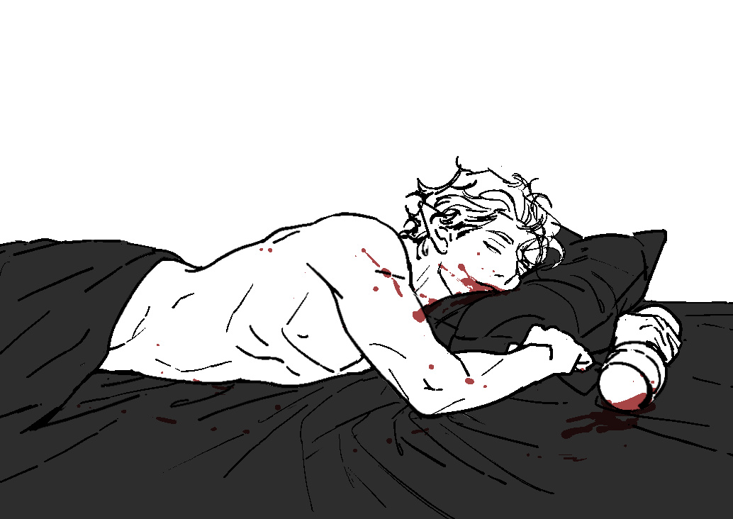
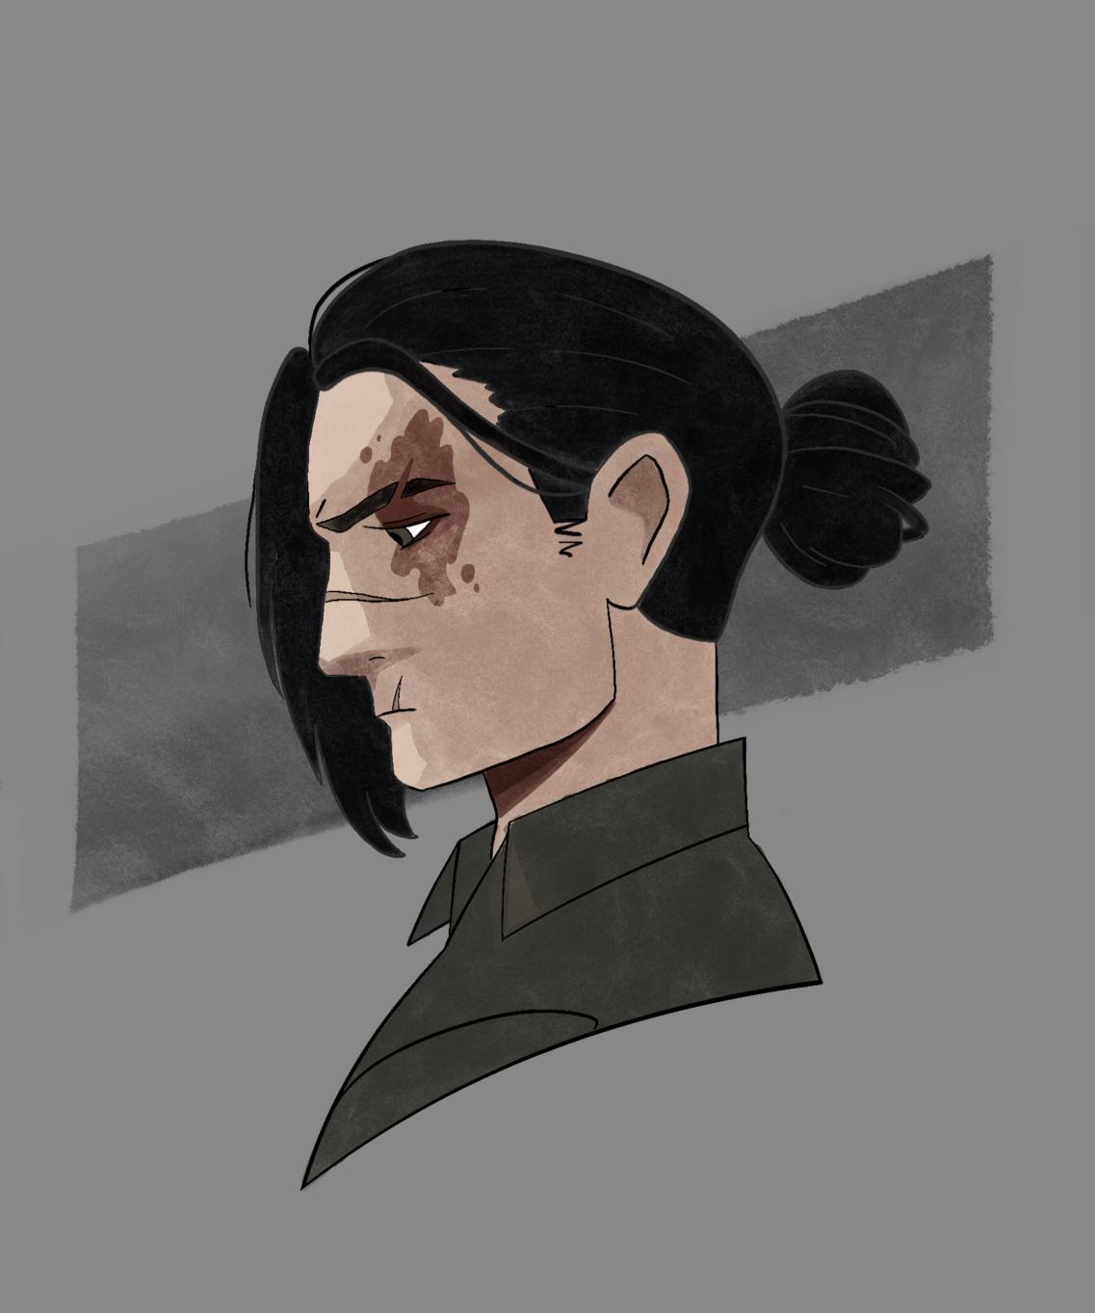
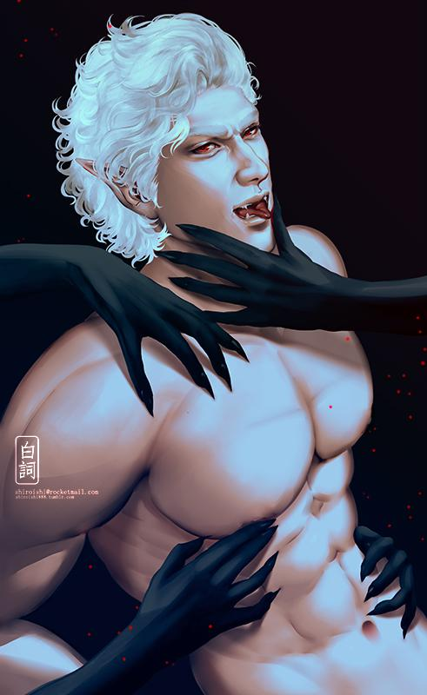
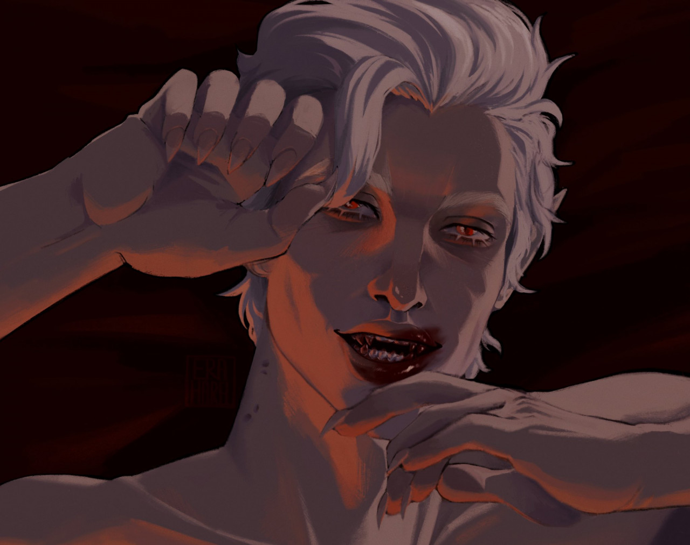
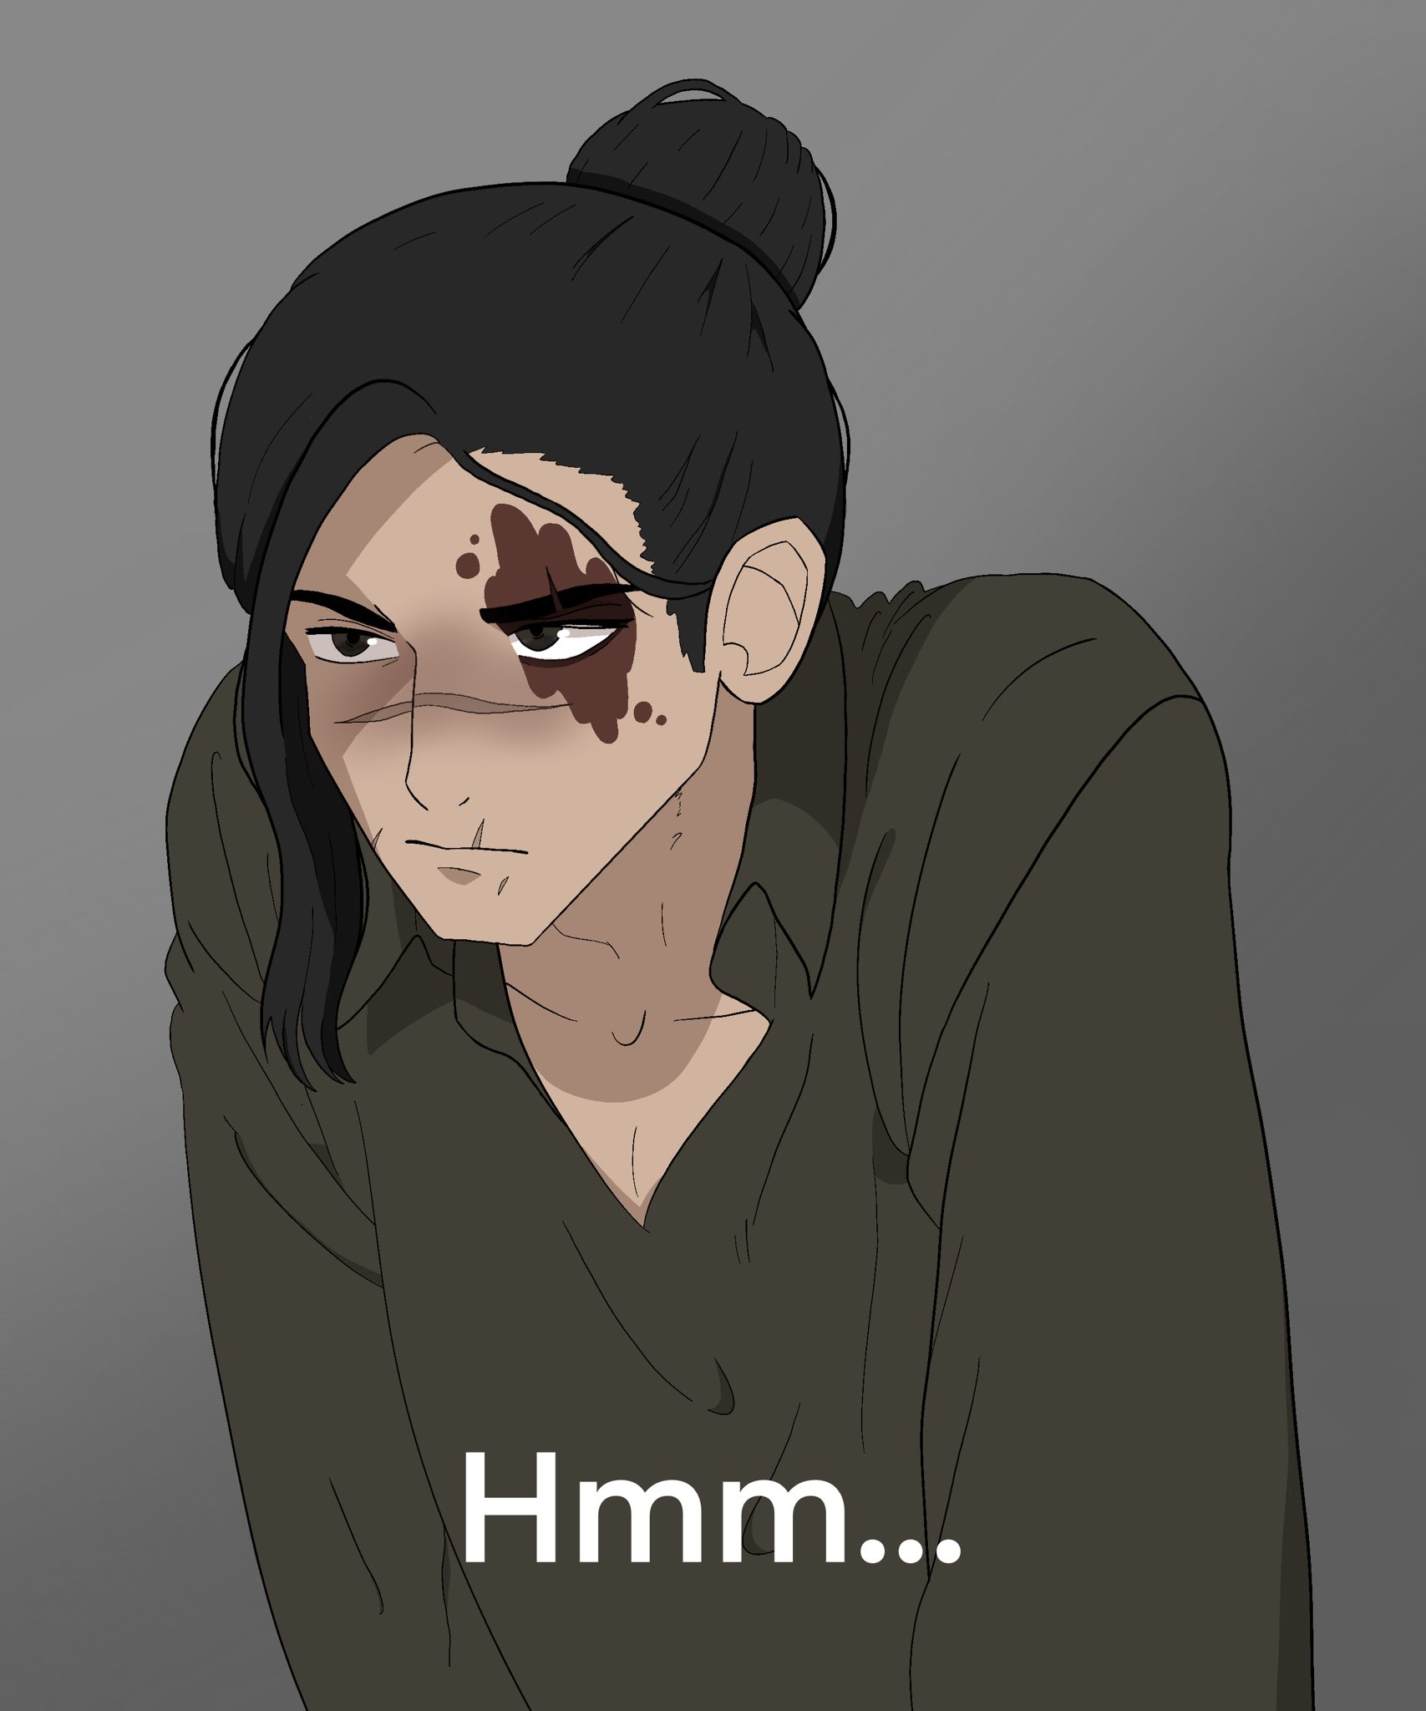
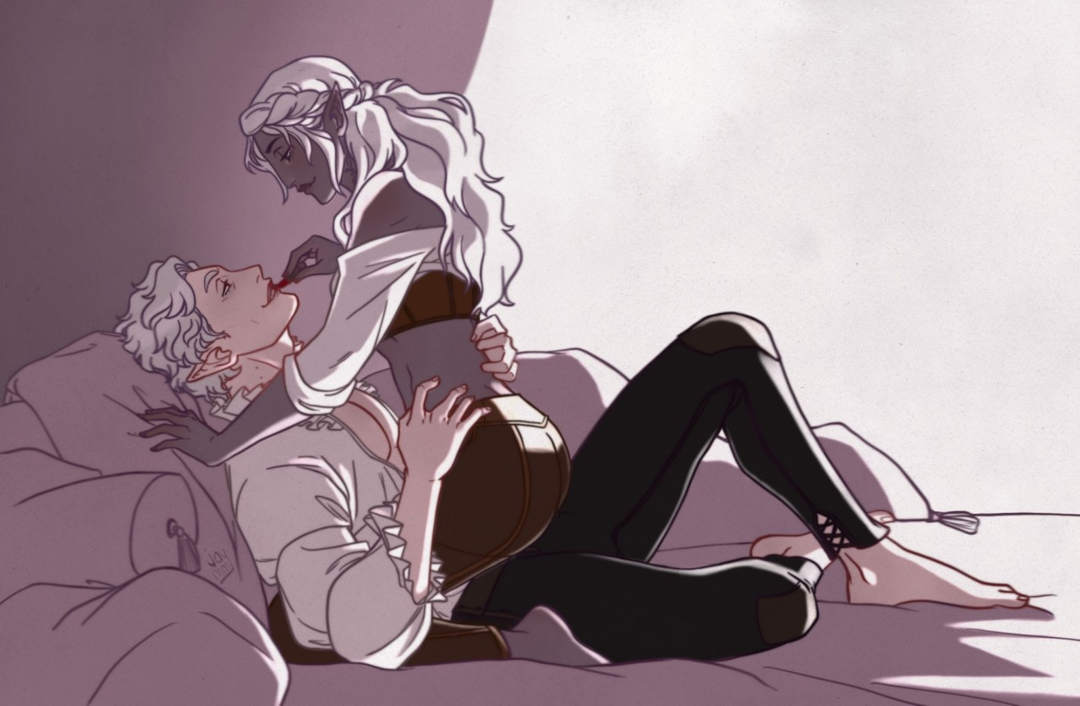
Baron Vasile, Lorentz, Vittorio

Slide 11
Baron Vasile, Lorentz, Vittorio
Fuck baron Vasile, UwU I can’t say no to him (and I don’t have the constitution for his brattiness)
Marry Vittorio you know I’m a stan for him
Kill Lorentz I’m sorry my priest boi the others are just too good Lorentz is meant for the baron

Slide 12
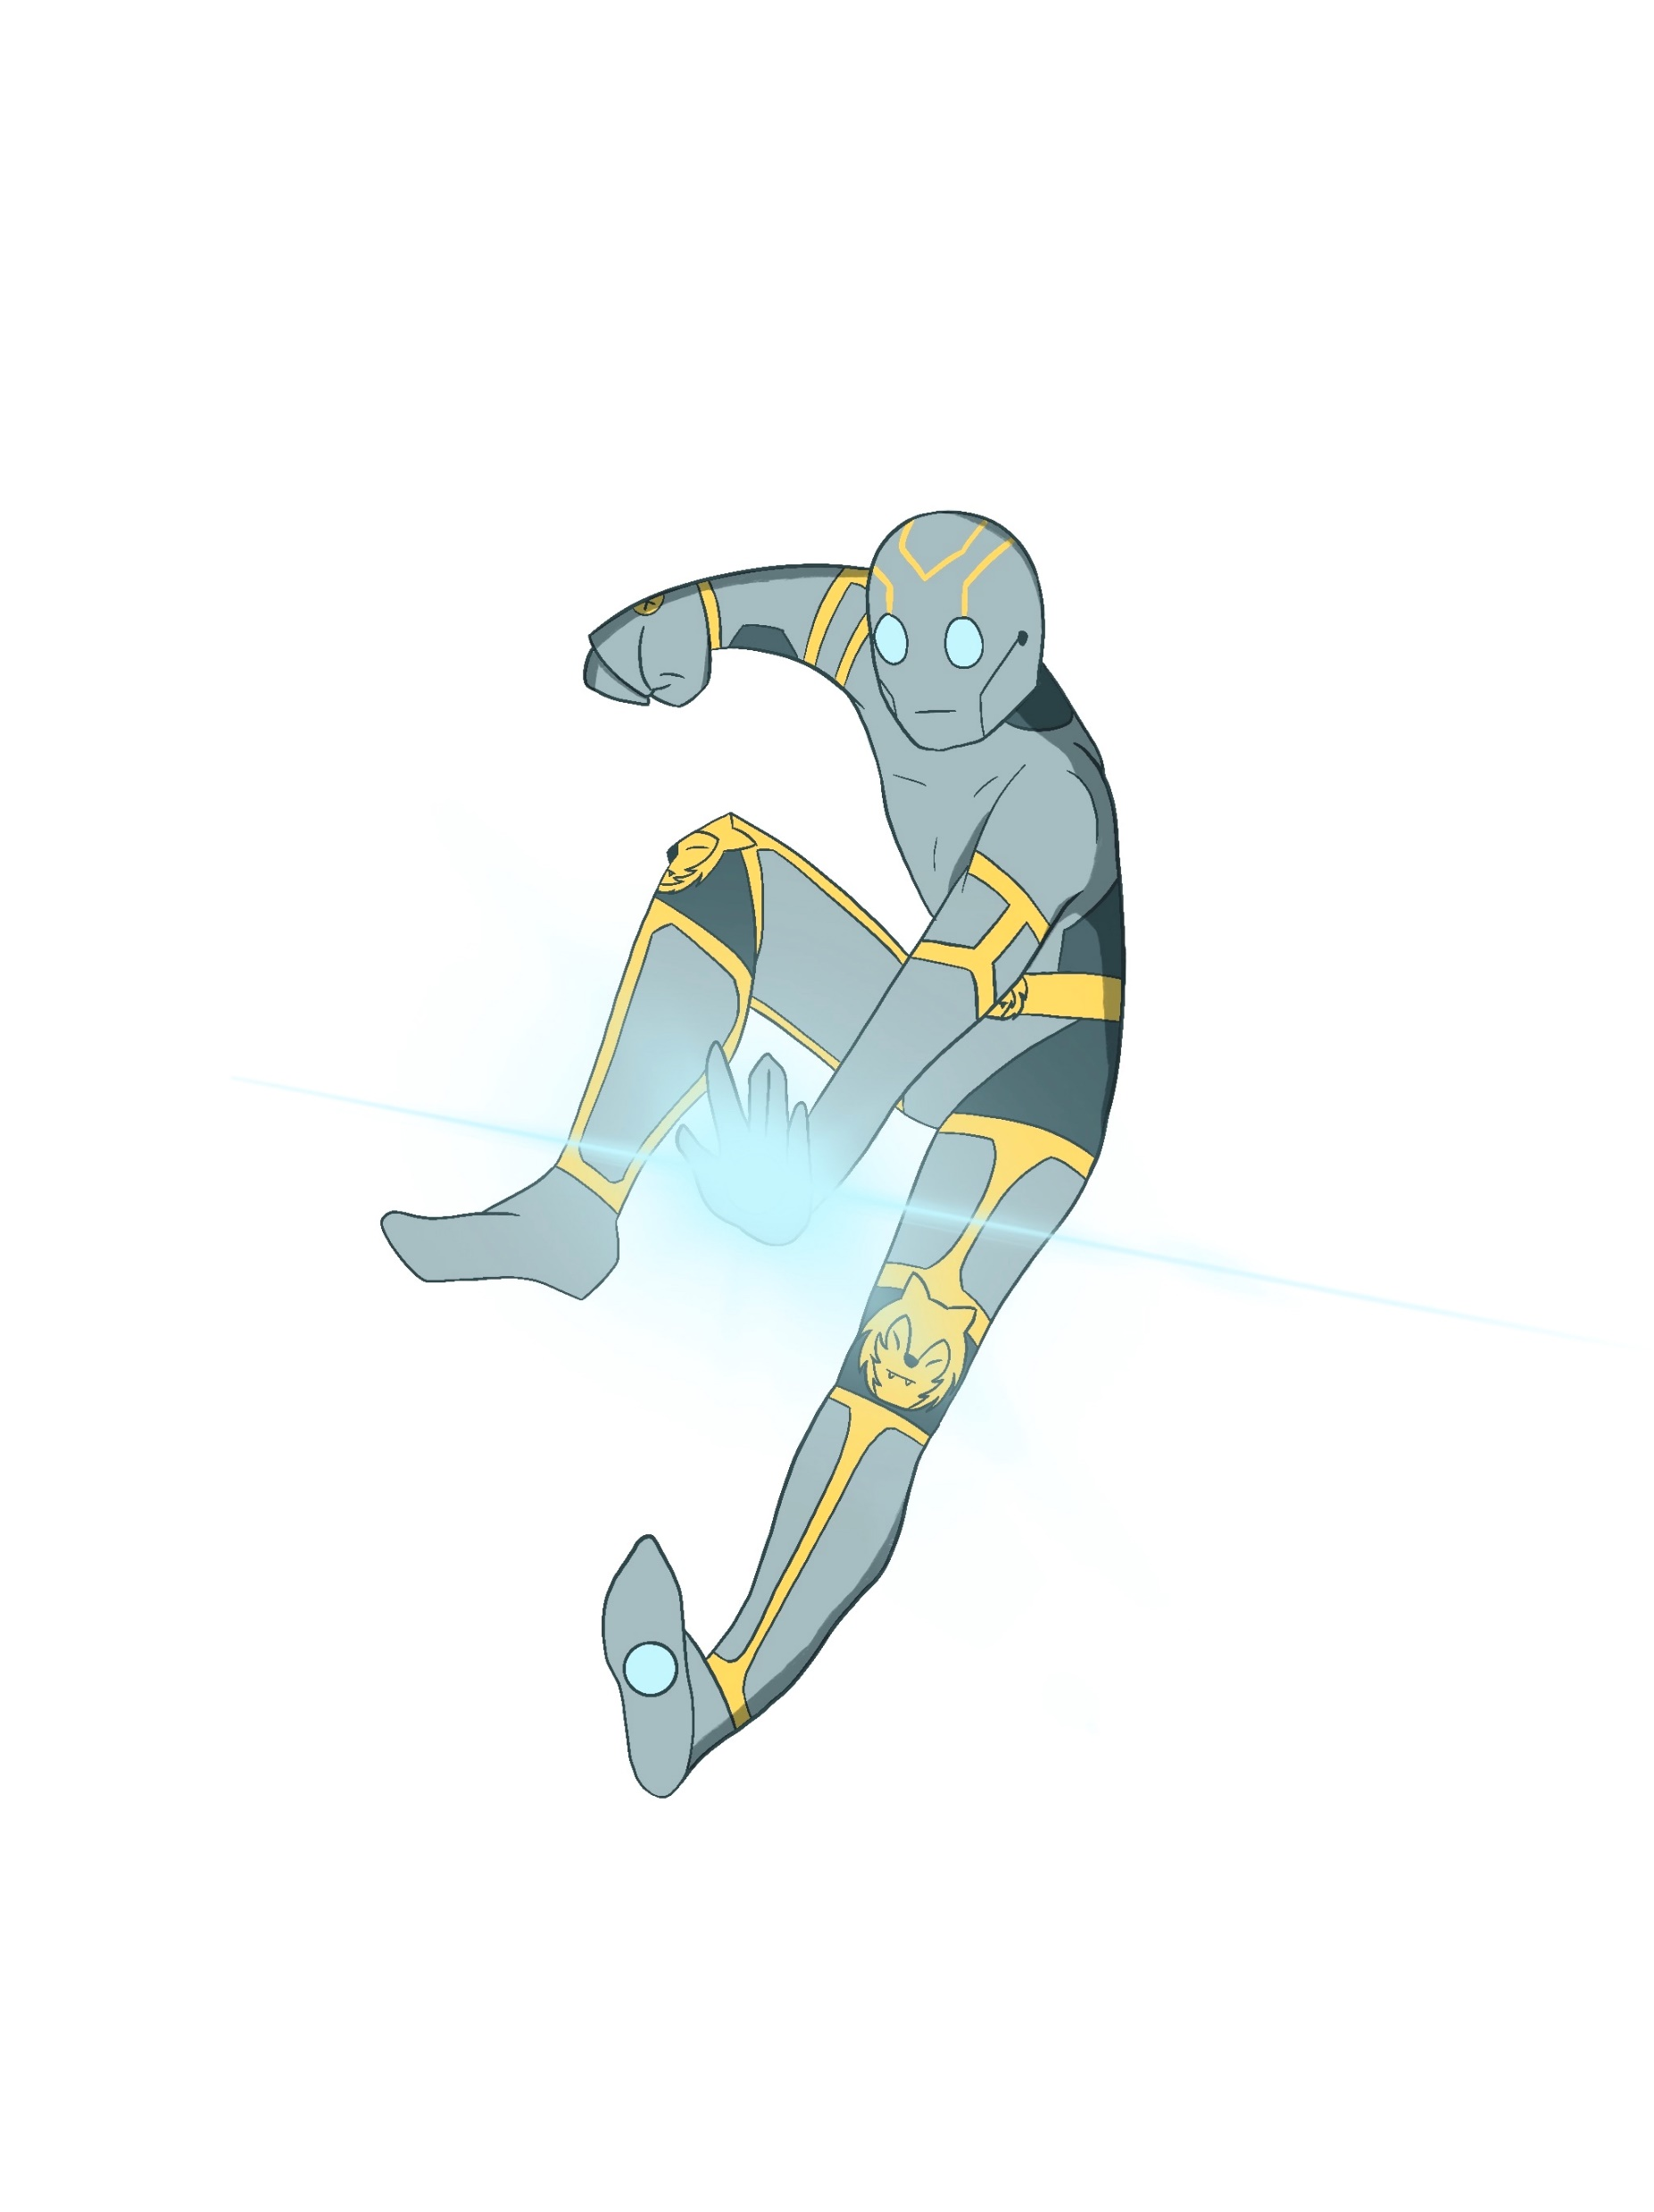
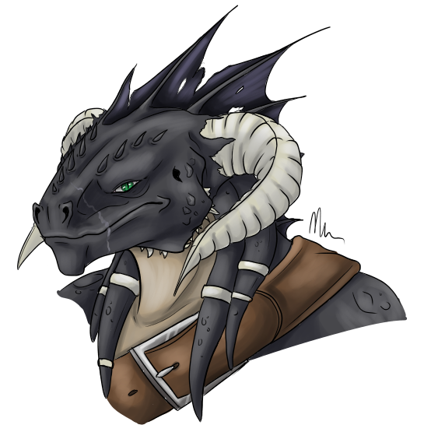
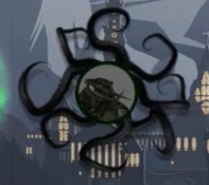
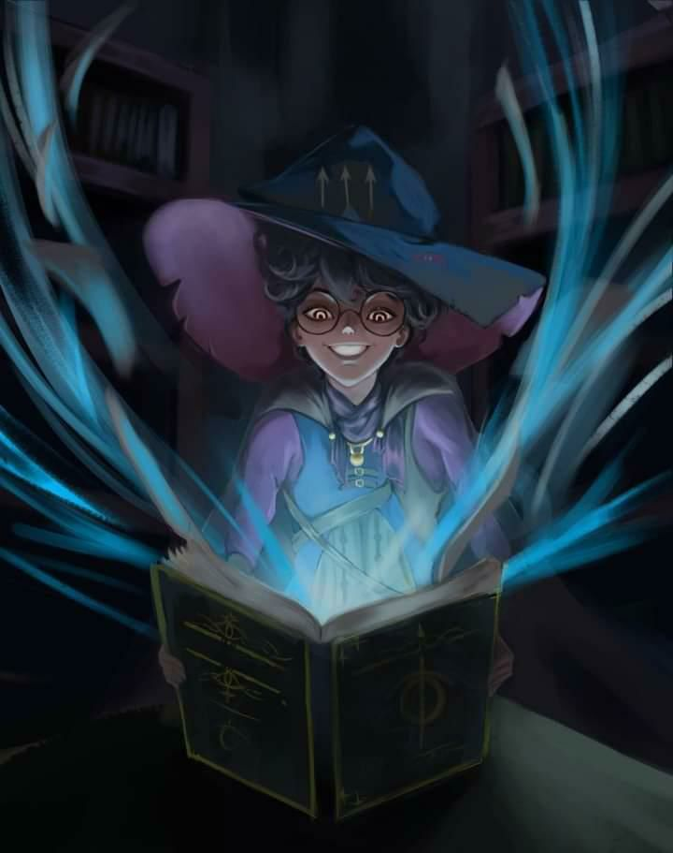
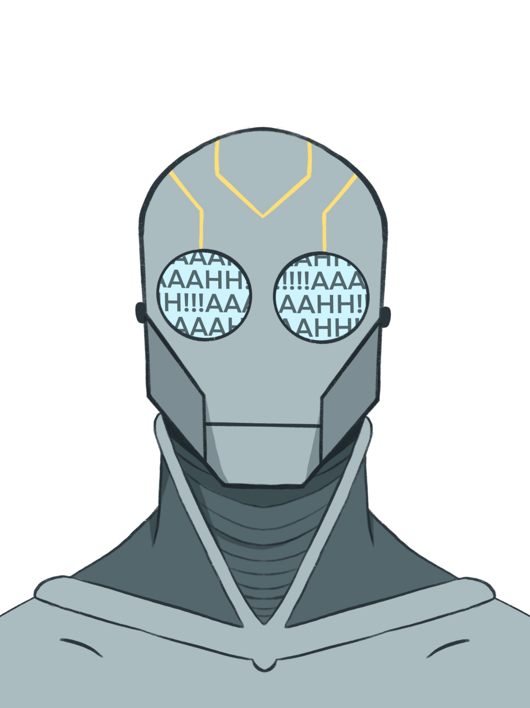
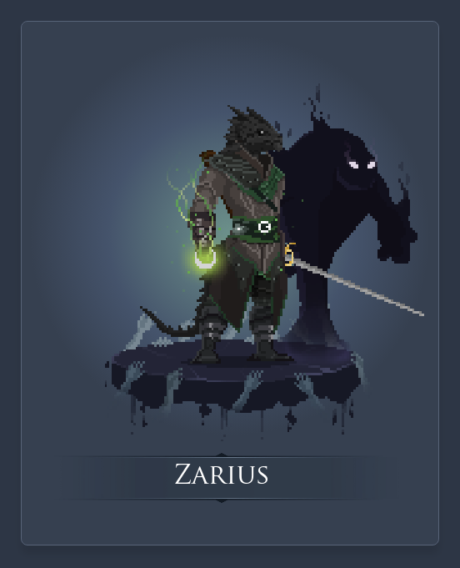
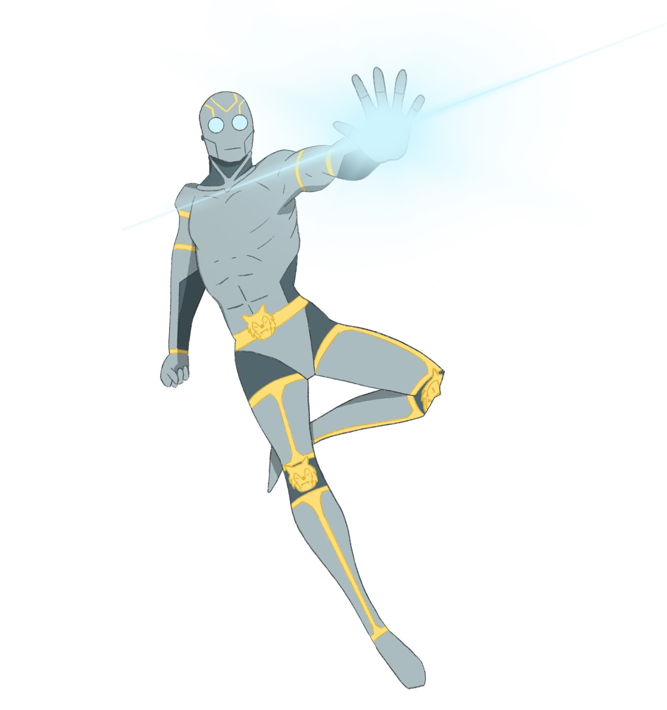
Zarius, Tokas, Unit

Slide 13
Zarius, Tokas, Unit
Fuck Tokas I guess? These are all bad options
Marry Unit, he would at least bring a dog into the relationship, and he’d hate to be touched so I can’t fuck him
Kill Zarius, he’s literally a lizard man

Slide 14
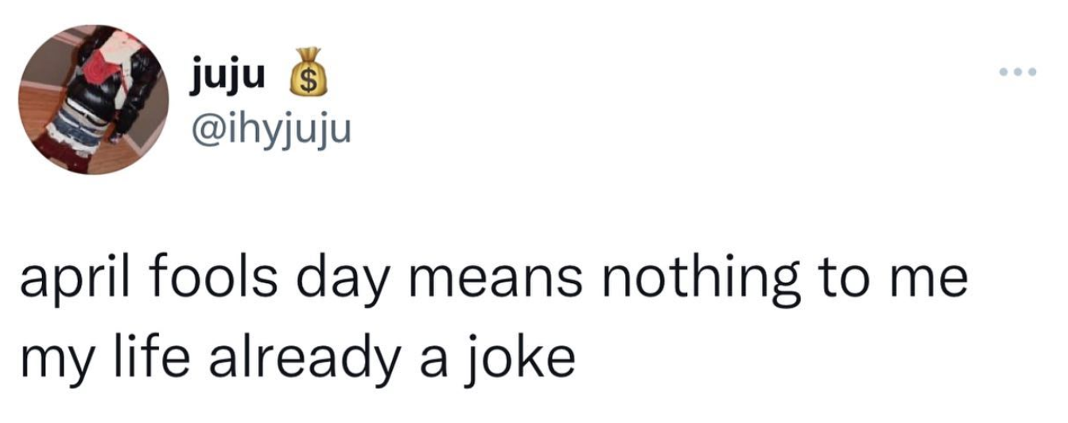
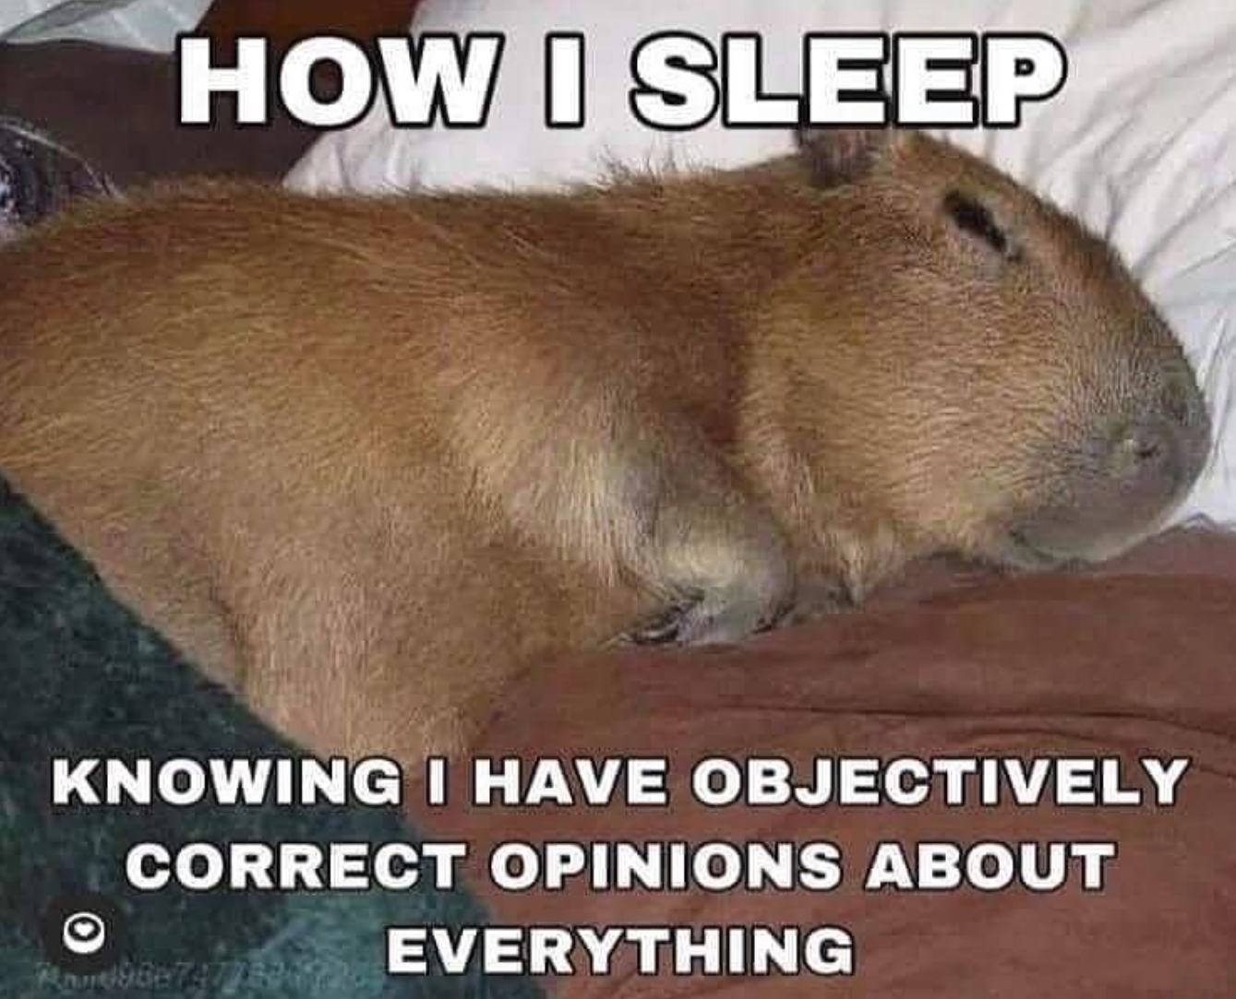

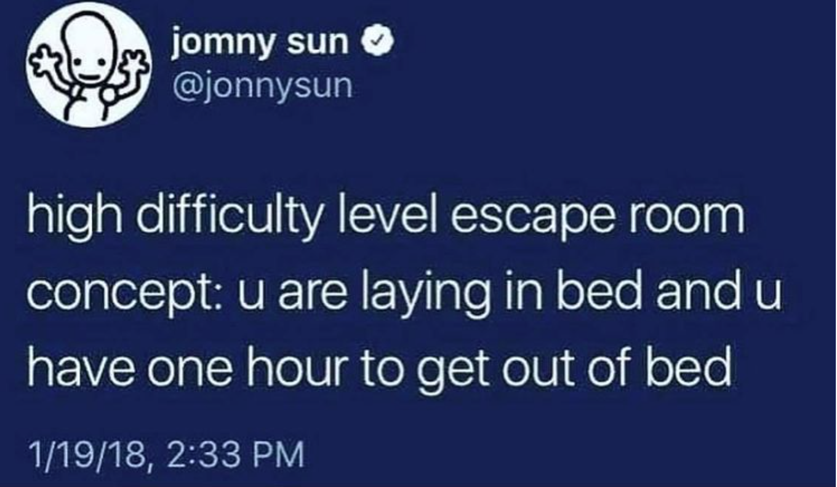


The end <3
The person who won can have a vinny pic whenever they want (although I’m at school sometimes so then I cannot make pic sadly any other time is fine tho)

